Slide 1
VIDEO RESUME
Final Presentation – Team 1

Slide 2
Agenda
Introduction
Project Architecture
Job Seeker
Employer
Admin
User Stories1-10
Extra features
Tools Used

Slide 3
Introduction
The aim of this project is to build an online job portal with a facility to upload their video resume.
The job seeker would be able to search and apply for jobs
The employer will be able to post jobs and can go through job seekers profile page.
Administrator monitors all activities

Slide 4
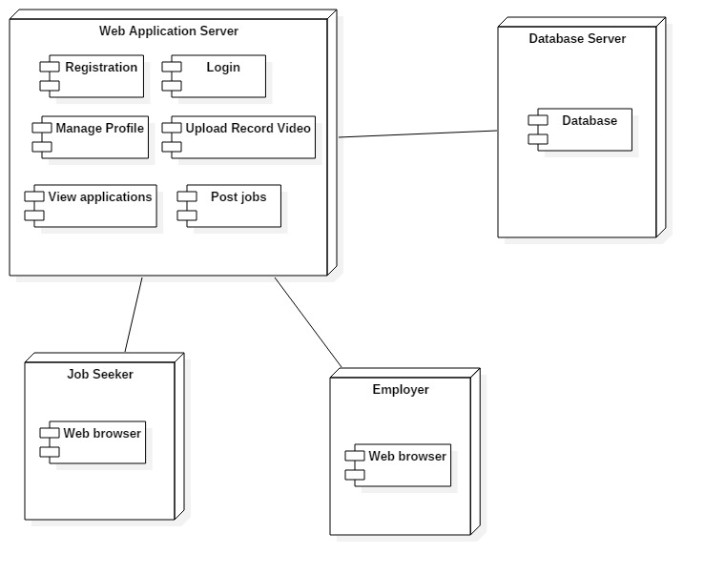
Project Architecture

Slide 5
Job Seeker
Sign in
Add their skills
Register
Job Seeker
Give one-way interview
Update personal details
Search for jobs
Record Video Resume
Upload Video Resume

Slide 6
Employer
Sign in
Register
Post Jobs
Employer
View job seekers application
View job seekers profile
Update his profile page
View the video resume
One-way interview questions

Slide 7
Admin
Remove unwanted videos
Sign in
Admin
Send warning
View videos posted by job seeker

Slide 8
User Story-1
Sign up feature for the job seekers to provide name, email address, phone number
The job seeker must be able to provide username and password

Slide 9
User Story-2
The job seeker must have a profile page which provides their personal details along with their education and other skills.

Slide 10
User Story-3
There should be a page where the job seeker can record or upload video resume as well as paper resume

Slide 11
User Story-4
The job seeker can search for job postings and can filter them according to his preferences

Slide 12
User Story-5
The job seeker can record one-way interview questions

Slide 13
User Story-6
The employer must have a sign up page containing his company details.

Slide 14
User Story-7
The employer will be able to post jobs.

Slide 15
User Story-8
The employer will be able to view the job seekers profile page and both the pages should be in different domain.

Slide 16
User Story-9
The employer can type their one-way interview question and the job seeker can view the one-way interview questions.

Slide 17
User Story-10
The employer will be able to view the video posted by the job-seeker.

Slide 18
Extra features
Apart from the user stories mentioned before we have also included some administrator functionalities.

Slide 19
Tools used
Eclipse Oxygen
My SQL workbench
Java
Media Recorder/Media Stream API

Slide 20
THANK YOU

